Slide 1
Welcome to Science!

Slide 2
Curriculum Night Schedule
1st - 6:00 - 6:12
2nd - 6:15 - 6:25
3rd - 6:28 - 6:38
4th - 6:41 - 6:51
5th - 6:54 - 7:04
6th - 7:07 - 7:17
7th - 7:20 - 7:30
“Knowing how to think empowers you far beyond those who know what to think”
-Neil deGrasse Tyson

Slide 3
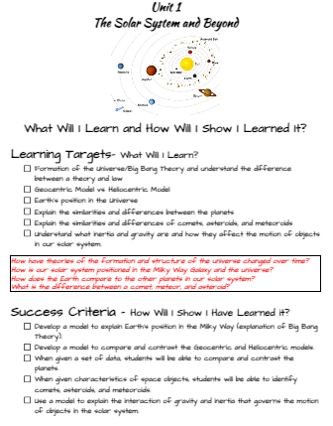
6th Grade Earth Science Curriculum
Unit 1 - Solar System and Beyond
Unit 2 - Earth-Moon-Sun
Unit 3 - Earth’s Changing Landscape
Unit 4 - Water in Earth’s Processes
Unit 5 - Climate and Weather

Slide 4
How is Science Education Changing?
Traditional | 21st Century
Start with Chapter One | Start with a Phenomenon
Teacher Asks Questions | Students Ask Questions
Cookie Cutter Labs | Student-Designed Labs
Lectures | Gathering Evidence
Memorizing Facts | Applying knowledge
Scientific Method | Science Practices/ Design Process
Unit Tests | Problem-Based Assessments

Slide 5
3 Dimensional Learning (3D)
Science and Engineering Practices
Disciplinary Core Ideas
Crosscutting Concepts
What students will be doing.
Asking Questions and Defining Problems
Developing and Using Models
Planning and Carrying Out Investigations
Analyzing and Interpreting Data
Using Mathematics and Computational Thinking
Constructing Explanations and Designing Solutions
Engaging in Argument from Evidence
This is the content only.
For example...
Structure and Properties of Matter:
Substances are made from different types of atoms, which combine with one another in various ways.
Atoms form molecules that range in size from two to thousands of atoms.
Intertwined themes
Patterns
Cause & Effect
Energy & Matter
Scale, Proportion, and Quantity
Systems and System Models
Structure and Function
Stability & Change

Slide 6
Student Expectations
Be Prepared for Class.
Be Respectful.
Participate.
Reach out for help.
Do Your Best Work!

Slide 7
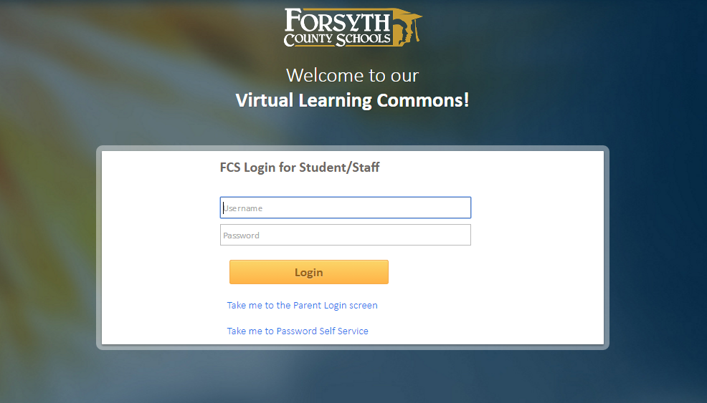
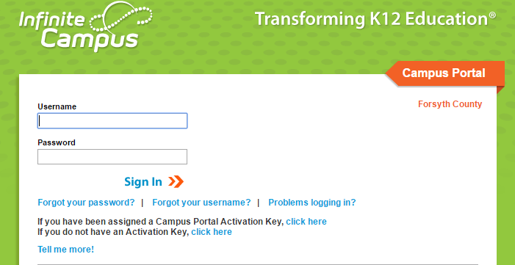
itslearning
Parent Portal
Weekly Slideshows
Classwork and homework assignments
Test dates
Project information and due dates
Resources and links
Check here for grades, missing assignments, etc.
If you don’t have one, check with Mrs. Menichino in the front office.

Slide 8
Thank you for visiting tonight!

